Slide 1
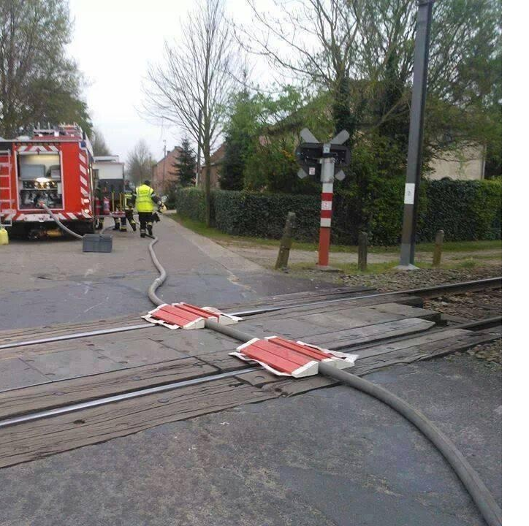
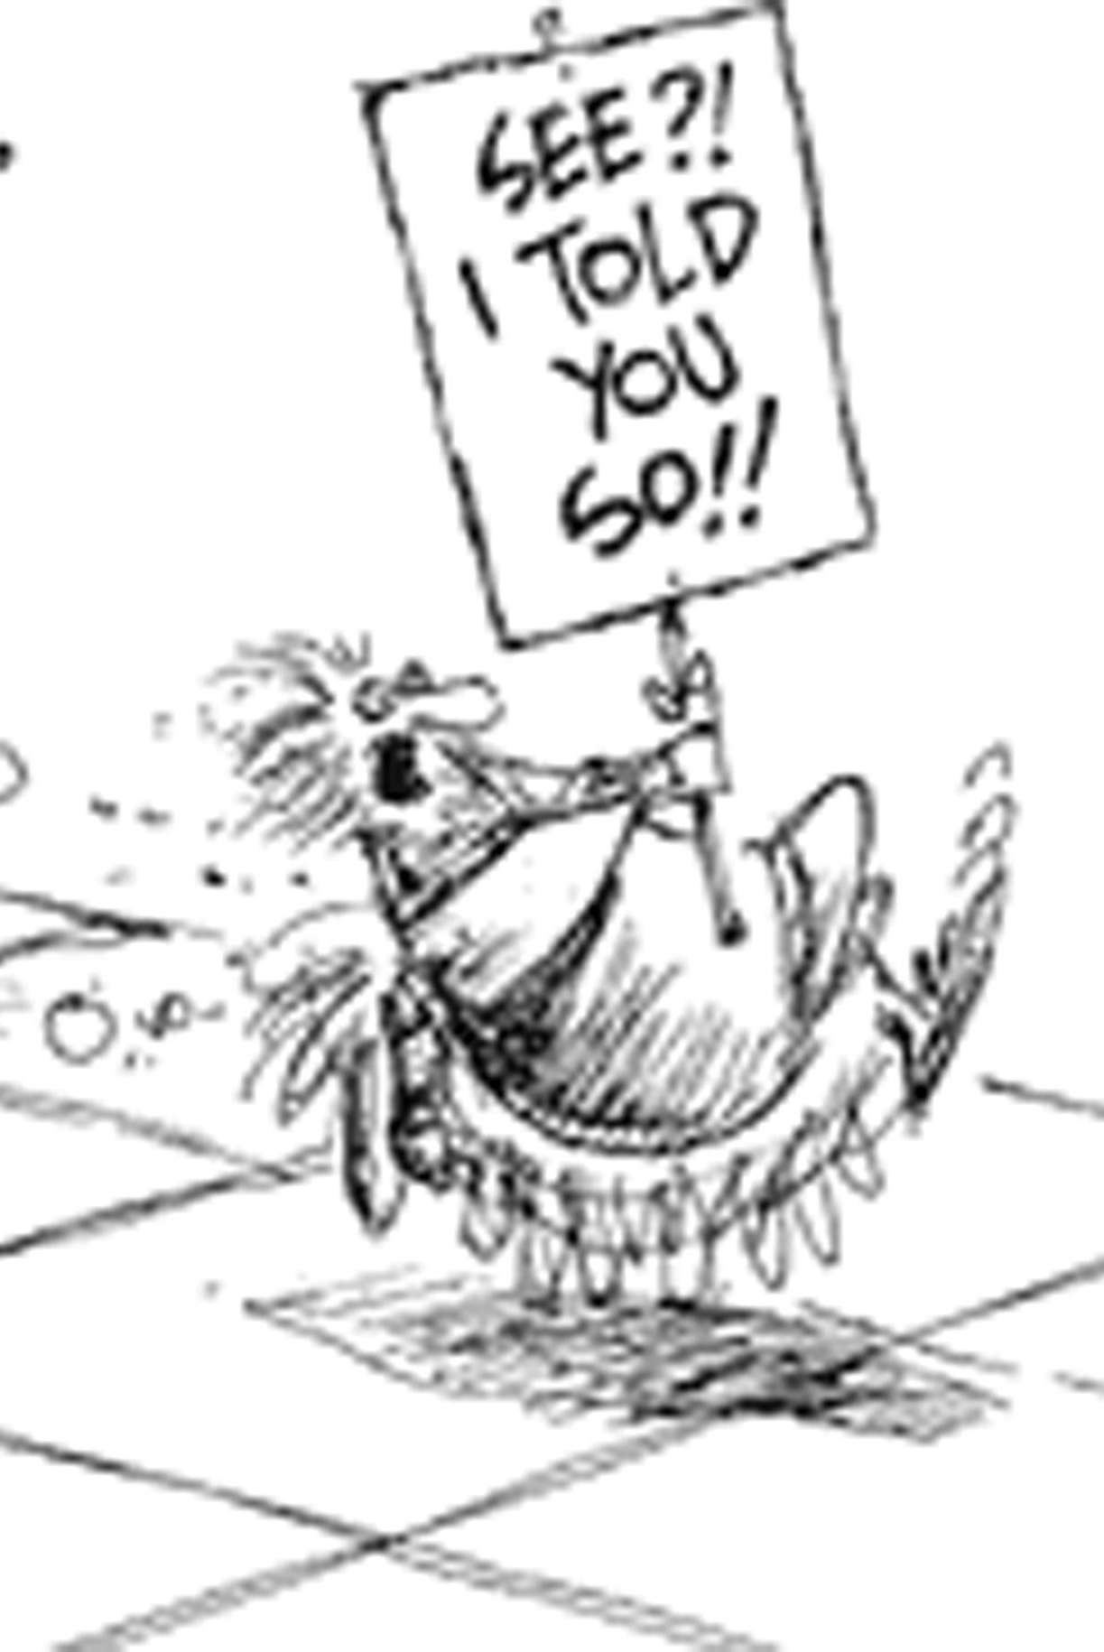
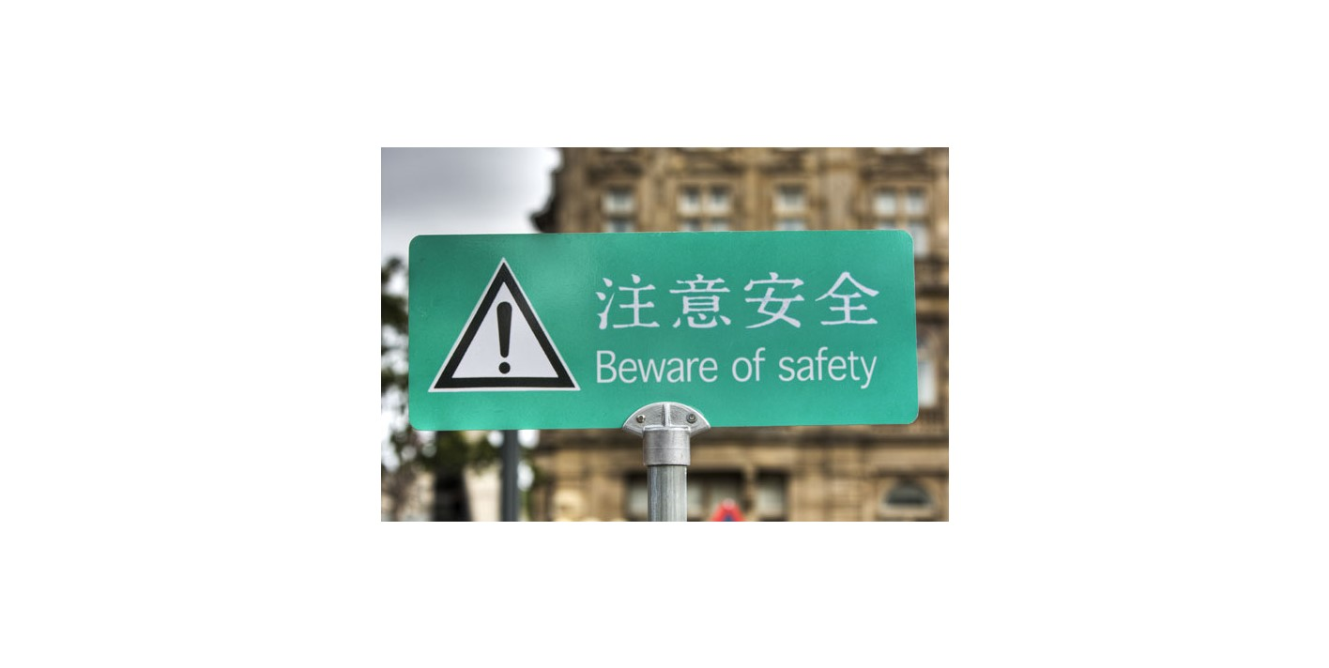

Slide 2
NASTTPO Conference May 2019
Legal, Regulatory, Litigation Updates

Slide 3
CRIMINALITY
DRAMATIC SHIFT TO CRIMINAL CHARGES IN CHEMICAL ACCIDENTS
HARRIS COUNTY CHARGES AGAINST AKEMA AND INTERCONTINENTAL TERMINALS - reckless assault
FEDERAL CHARGES AGAINST MIDWEST GRAIN PRODUCTS AND HARCROS – MARCH 2019
KNOWING AND NEGLIGENCE RELEASES UNDER THE CLEAN AIR ACT

Slide 4
LITIGATION
EPA SUED OVER FAILURE TO PROPOSE WORST CASE SPILL REGULATIONS UNDER CLEAN WATER ACT
33 USC 1321 (j) Filed March 21, 2019
LARGEST FORESEEABLE DISCHARGE IN ADVERSE WEATHER CONDITIONS, INCLUDING FIRE OR EXPLOSION
SPECIFY EQUIPMENT, PERSONNEL, TRAINING AND EQUIPMENT
DIFFERENT THAN ACCIDENT PREVENTION REGULATIONS

Slide 5
FLINT WATER CONTAMINATION
EPA CAN BE SUED FOR NEGLIGENCE
Officials and employees negligently responded to the water crisis, including by failing to utilize the agency’s enforcement authority under the Safe Drinking Water Act
Plaintiffs relied on EPA’s assurances of safety and were harmed

Slide 6
OTHER Litigation
Dep't of Labor & Indus. v. Heltzel, (Pa.)
EPCRA “preempts” state open records rules
PublicSource v. Pa. Dep't of Labor & Indus., (W.D. Pa.)
EPCRA requires Tier II information request to specify the facility
Californians for Renewable Energy et al. v. U.S. EPA et al., 4:15-cv-03292, ND CA
Environmental justice for emergency release impacts in new permits

Slide 7
SUING SERCs & LEPCs
NJ Work Environment Council et al v. NJ SERC & Linden LEPC
Failure of the LEPC to prepare a plan
No action directly against an LEPC
Sue the SERC

Slide 8
AMERICA’S WATER INFRASTRUCTURE ACT
A State emergency response commission shall-
"(A) promptly notify the applicable State agency of any release that requires notice under subsection (a);
"(B) provide to the applicable State agency the information identified in subsection (b)(2); and "(C) provide … [any] written followup
The term “applicable State agency” means the State agency that has primary responsibility to enforce the requirements of the Safe Drinking Water Act.
RELEASES FROM FACILITIES – NOT TRANSPORTATION
SERC NOT RESPONSIBLE FOR INFORMATION TO WATER UTILITIES

Slide 9
AVAILABILITY OF DATA TO COMMUNITY WATER SYSTEMS - AWIA
“An affected community water system may have access to tier II information by submitting a request to the State emergency response commission or the local emergency planning committee. Upon receipt of a request for tier II information, the State commission or local committee shall, pursuant to paragraph (1), request the facility owner or operator for the tier II information and make available such information to the affected community water system.”

Slide 10
WHAT DOES THIS MEAN
IDENTICAL TO CURRENT REQUIREMENT FOR A REQUEST BY “State or local official acting in his or her official capacity” 312 (e)
I DON’T THINK THIS MEANS THE ENTIRE TIER II DATABASE
DOES INCLUDE FACILITIES THAT ARE NOT TIER II REPORTERS
THE LEPC CANNOT REFUSE TO PURSUE TIER II DATA; HOWEVER, WHAT THRESHOLDS?
DON’T THINK LEPCs HAVE TO HUNT FOR FACILITIES

Slide 11
EMERGENCY RESPONSE PLANS - AWIA
TIERED DEADLINES – OVER 100,000 MARCH 31, 2020
RISK TO THE UTILITY, ALTERNATIVE SUPPLIES, RELOCATION OF INTAKES, FLOOD PROTECTION
COORDINATE WITH LEPCs

Slide 12
HAZMAT ROUNDTABLE
LEPCs and first responder organizations are responsible to the community for community preparedness. Effective preparedness … develop answers to:
- What are the hazardous material accident risks of transportation and facilities in your community and how are they being prevented?
- What are the plans and capabilities of the community should an accident happen?
- What are the roles and responsibilities of all community members an emergency?
- What capability gaps exist and then create a plan to fill those gaps based on community priorities.

Slide 13
Disaster Recovery Reform Act
FEMA to provide information and resources on improving resilience to hazardous materials incidents
Local governments are responsible for the integration of hazardous material planning and response
Significant role for LEPCs, but misapprehends modern role of LEPCs
Meeting in June

Slide 14
REGULATIONS
CAFO – Final EPCRA exemption rule
To be signed on the 23rd (litigation likely)
RMP – Your guess is as good as mine
Few portions of the existing rule will survive is my guess
CWA – Accident prevention
Once the decision to “punt” is finalized EPA will be sued

Slide 15
GUIDANCE IS ENFORCABLE
CPG 101
Continuity Guidance Circular
NFPA 1600 New Version Now Effective
ASTM Task Group for a New Standard
Cooperation and Coordination

Slide 16
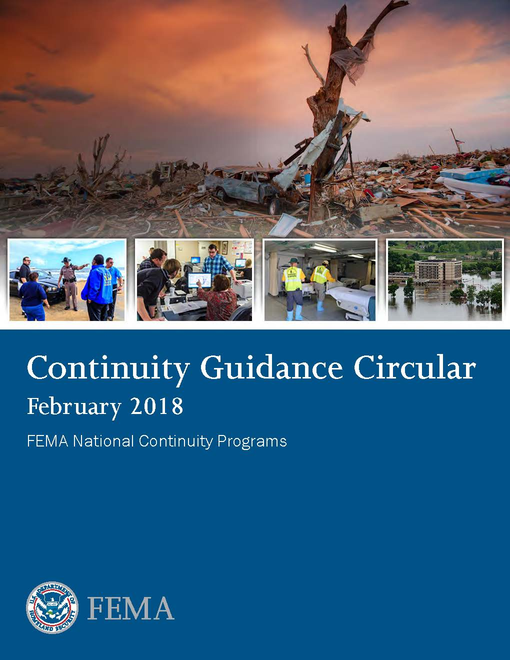
CPG 101
“When threatened by … emergencies …, people expect elected or appointed leaders to take immediate action...
The elected leaders in each jurisdiction are legally responsible for ensuring that … actions are taken to protect people ...”
Continuity Guidance Circular
“Planning across the full range of continuity operations is an inherent responsibility of every level of government.”
“[E]nsure that essential functions continue to be performed…”
“Essential functions … cannot be deferred during an emergency; … legally mandated functions will be essential …”

Slide 17
BEST PRACTICES – NASTTPO
Honor your community conditions/priorities
vision of success
Understand the risks
Realistically understand capabilities
Communicate to create realistic expectations
Prevention vs response
Strategic plan to fill gaps
Do projects that fill gaps – MEASURE SUCCESS

Slide 18
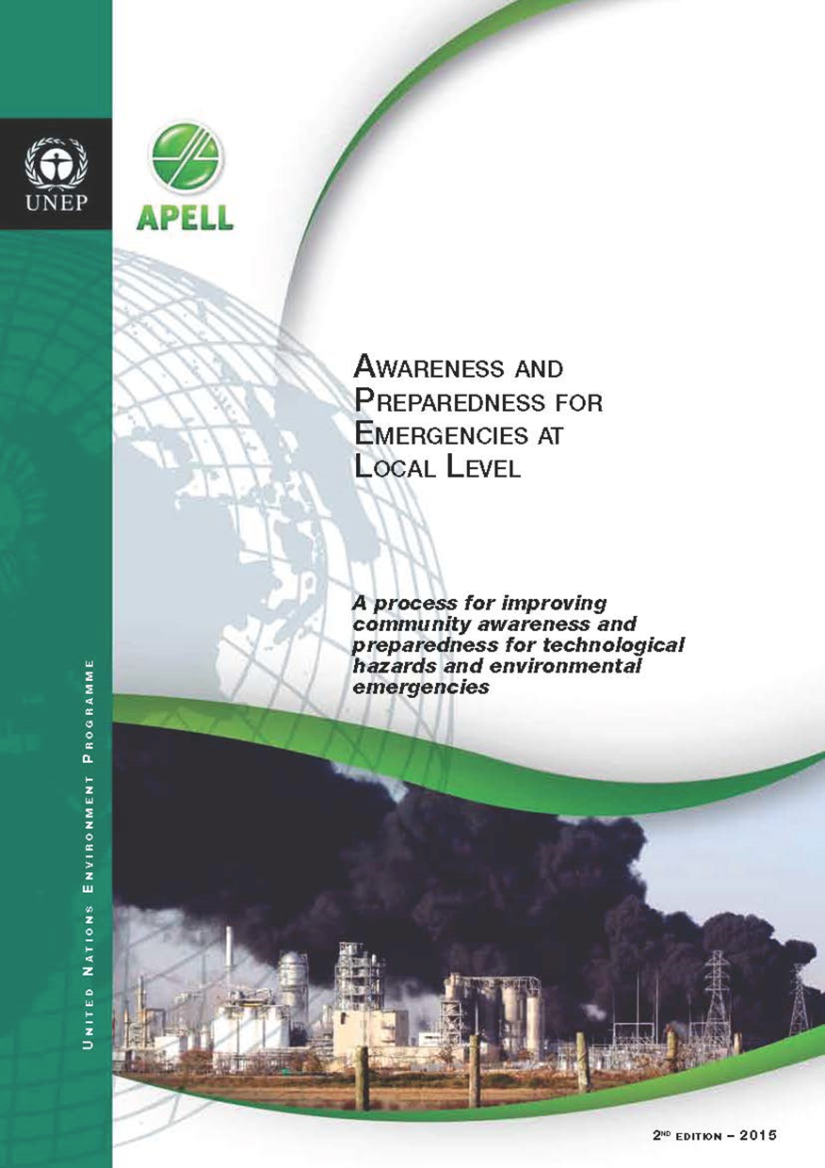
http://apell.eecentre.org/
EPA’s Measuring Success Document
http://www.epa.gov/sites/production/files/2013-08/documents/measuring_progress_lepc.pdf

Slide 19
Timothy Gablehouse
tgablehouse@att.net
303.572.0050
Let me know if you want to be on the email list

