Slide 1
Toxics Release Inventory
(EPCRA 313) and
Pollution Prevention Act of 1990 :
Latest Updates / New Products
Steve Witkin
Sarah Swenson
TRI Program / USEPA
May 2019

Slide 2
Presentation Overview
3 Minute Summary of TRI
How You Can Use TRI Data and information
TRI Program Updates
TRI Resources and Contacts

Slide 3
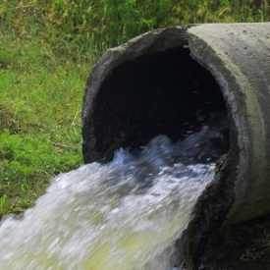
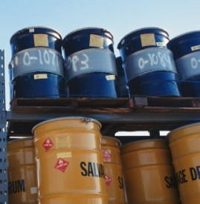
What is the Toxics Release Inventory (TRI)?
Reporting program tracking the waste management of certain chemicals
Facilities report to states/tribes and to EPA each year
TRI includes information on:
And much more!
Releases
Waste
transfers
Recycling
Pollution prevention

Slide 4
Purpose of TRI Information
“To inform persons about releases of toxic chemicals to the environment; to assist governmental agencies, researchers, and other persons in the conduct of research and data gathering; to aid in the development of appropriate regulations, guidelines, and standards; and for other similar purposes.” 42 USC 11023(h)
4

Slide 5
Summary of Available Data
You already know TRI has data on:
Quantities chemicals released to air, water, land
One-time/accidental releases
Pollution prevention (P2) and source reduction activities
You may not know TRI data include:
Name of receiving waterbody and REACH code (for surface water discharges)
Maximum amount of each chemical on site (a range)
Quantities of waste managed (not released)
Quantity of each chemical shipped off-site (annually) and name of each receiving facility
Method of data estimation
Method of waste treatment
5

Slide 6
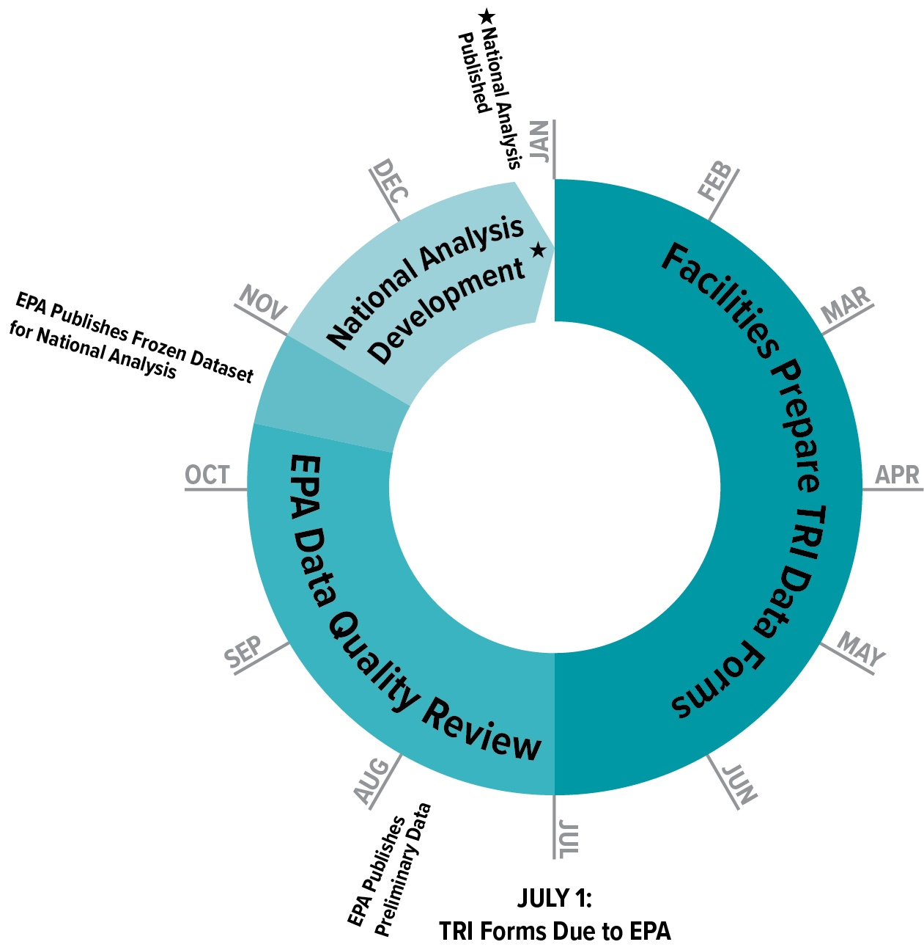
Annual TRI Data Cycle
TRI forms due every July 1 for the previous year’s data
Preliminary dataset available in July
Ongoing data quality checks and compliance assistance
TRI National Analysis (EPA’s annual TRI report) is published in January
Note that previous years’ data are retained and periodically “refreshed”

Slide 7
Available tools and information*
TRI Program website
TRI Program background and basics
TRI-covered industries and chemicals
TRI reporting requirements
Examples of how TRI data have been used
Tools for:
Community outreach
Quick looks and basic analyses
Advanced analyses
Basic relative potential risk screening
*Certain content is available in Spanish

Slide 8
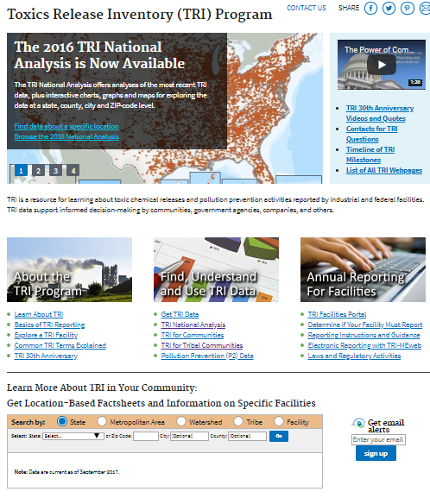
Basic Program Info
Facility resources
Community resources
Data access and analytic tools

Slide 9
How can TRI data and information be used?
You already know you can use TRI to find:
Annual release quantities
One-time or accidental release quantities
You may not know you can use TRI data to:
Look at chemical release trends over time for a particular facility, ZIP code locality, or county
Map facilities sending and receiving chemical waste
Prioritize local efforts to reduce pollution from facilities
Promote “tech transfer” of innovative P2 activities: from facilities successfully using P2 to facilities that could start using similar approaches

Slide 10
Other Uses of TRI
Prepackaged content for community outreach
Inform county planning and zoning decisions
Local/state/tribal priority-setting based on relative potential risk
Identify local facilities treating toxic waste in an environmentally responsible manner

Slide 11
TRI Program Updates
Chemical Additions | First Year to Be Reported
1-Bromopropane | 2016
Hexabromocyclododecane (HBCD) category | 2017
Nonylphenol Ethoxylates category | 2019
PFAS Chemicals EPA’s PFAS Action Plan (Feb 2019) lists 2019 as date to start activities to consider additions. | No earlier than 2020
Toxics Use Reduction Institute (TURI) Petition 25 Chemicals under review to determine if they meet TRI listing requirements
Notes:
PFAS - See page 18/19 of https://www.epa.gov/sites/production/files/2019-02/documents/pfas_action_plan_021319_508compliant_1.pdf
TURI – For list of chems see petition at https://www.epa.gov/sites/production/files/2016-09/documents/turi_petition_complete.pdf

Slide 12
TURI Chemicals
Formamide | 2,5-dinitrotoluene
Hexahydrophthalic Anhydride | Dibutyltin dichloride (DBTC)
1,2,3-trichlorobenzene | 1,3,4,6,7,8-Hexahydro4,6,6,7,8,8- hexamethylcyclopenta(g)-2-benzopyran
1,3-Dichloro-2-propanol
n-propyl bromide (1-bromopropane) | Hexabromocyclododecane
Aminoethylethanolamine | Nitrilotriacetic acid, trisodium salt
Tris(2-chloroethyl) phosphate | p-a,a,aTetrachlorotoluene
N-methylformamide | Tris(1,3-dichloro-2-propyl) phosphate (TDCPP)
1,1’- Azobis(formamide) | Nonylphenol (Added to TRI RY 2019)
N,Ndimethylacetamide | Trixylyl phosphate
4-tertOctylphenol=1,1,3,3- Tetramethyl-4-butylphenol | Triglycidylisocyanurate,TGIC,Teroxirone, Tris(epoxypropyl) isocyanurate
Cyclododecane | Hexahydromethyl phthalic anhydride
2,3-dinitrotoluene | Diphenyl ether, octabromo derivative
Notes:
PFAS - See page 18/19 of https://www.epa.gov/sites/production/files/2019-02/documents/pfas_action_plan_021319_508compliant_1.pdf
TURI – For list of chems see petition at https://www.epa.gov/sites/production/files/2016-09/documents/turi_petition_complete.pdf

Slide 13
TRI Program Updates
Documents / Web Site |  | Changes
Factors to Consider When Using TRI Data | Document | Revised March 2019
TRI for Researchers | Web Page | New
TRI for Tribal Communities | Web Page | Major Revision
Introduction to TRI for Industry | (Online) Slide Presentation | Tailored for Industry
Activities in Progress
Factors to Consider | Document | Broad Overhaul
How TRI Relates to Other EPA Programs | Document / Visual | New / Rework
Starter Kit | Document | New Aid

Slide 14
TRI Program Updates
Tools |  | Changes
MyRTK | Mobile App for Citizens | Improved Mapping and Search Function
TRI Explorer | Balanced tool Preformatted reports / Summary level results | Editorial clean-up Multiple minor bugs fixed
EZ Query | Data Access tool | QA review, update to query logic
Basic and Basic Plus Files | Downloadable data files | Major update to documentation
Guide-ME | Guidance Search Tool | Consolidation of References / Technical Updates

Slide 15
Connect With Us
Email bulletin sign-up in right hand sidebar of www.epa.gov/tri

Slide 16
Contacts
tri.help@epa.gov (TRI staff will respond)
TRI Program Contacts:
Steve Witkin: Witkin.Steve@epa.gov
Sarah Swenson: Swenson.Sarah@epa.gov
Judy Kendall, Regional/State Liaison: Kendall.Judith@epa.gov
Shelley Fudge, Community/EJ/Tribal Coordinator : Fudge.Shelley@epa.gov
Wayne Davis, RSEI lead: Davis.Wayne@epa.gov

Slide 17
Regional and State Contacts
TRI Regional Coordinators: www.epa.gov/tri/regionalcoordinators
TRI State Coordinators: https://www.epa.gov/toxics-release-inventory-tri-program/tri-state-contacts

Slide 18
Resources
Toxics Release Inventory Program: www.epa.gov/tri
TRI National Analysis: www.epa.gov/trinationalanalysis
Risk-Screening Environmental Indicators (RSEI): www.epa.gov/rsei
TRI Data and Tools: www.epa.gov/tri/tri-data-and-tools
TRI GuideME: Searchable TRI guidance documents, Q & As, and reporting instructions
TRI for Communities: www.epa.gov/tri/communities
TRI & P2: www.epa.gov/tri/p2

